Slide 1

Rekayasa-balik
Reversing.ID
Sebuah Hikayat dari
Dunia Digital
28/09/2018 @ Born To Protect (Indonesia)

Slide 2
Komunitas Reversing.id
Mereka yang berserikat
untuk satu tujuan.

Slide 3
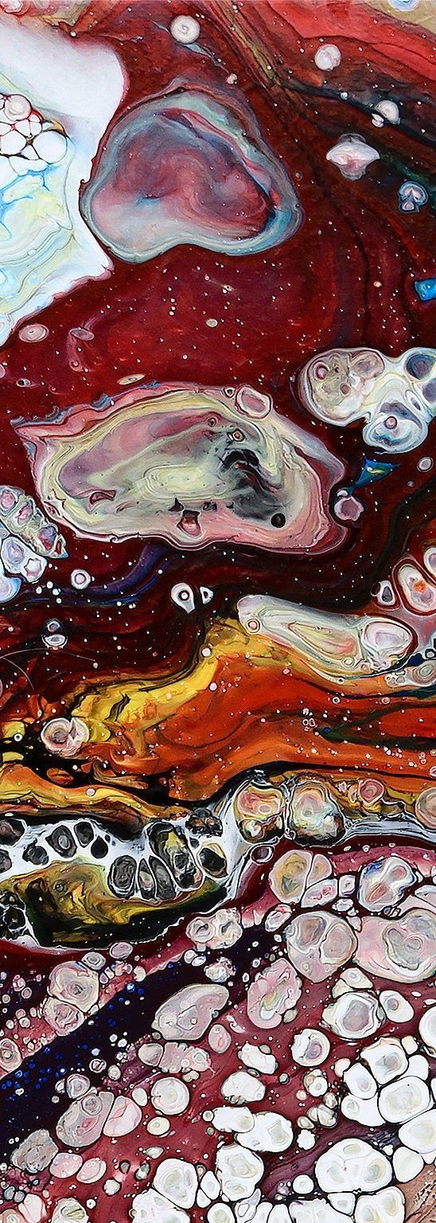
Who are we?
Komunitas untuk berdiskusi teknis dengan tema spesifik Reverse Engineering dan hal-hal terkait (binary analisis, exploit development, crypto analysis).
Tempat nongkrong (free to join):
Telegram @ReversingID.
Facebook Reversing.ID.
Github https://github.com/ReversingID .

Slide 4

Yang Kami Lakukan
Sharing.
Breaking challenge.
Have fun.

Slide 5

Hakikat reversing
Titik akhir merupakan
awal yang baru.

Slide 6
Cracking??
Reversing itu …

Slide 7
Reverse engineering
Bermain-main dengan sesuatu yang belum diketahui
Memecahkan misteri
Mempelajari bagaimana sesuatu bekerja
Memodifikasi maupun menghasilkan sesuatu dari pengetahuan yang didapat.
“Knowledge is power, but only wisdom is strength.”

Slide 8
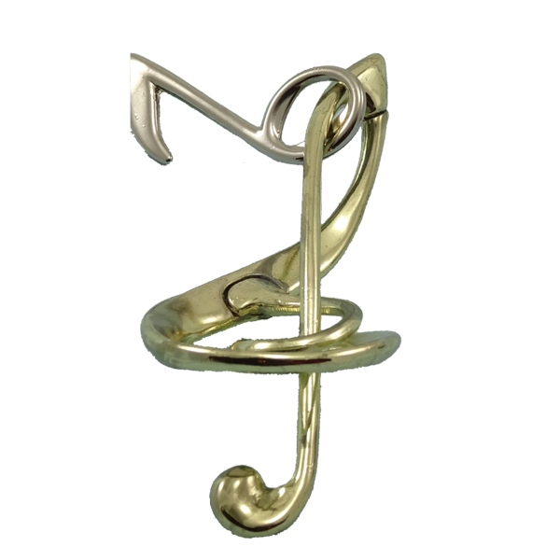
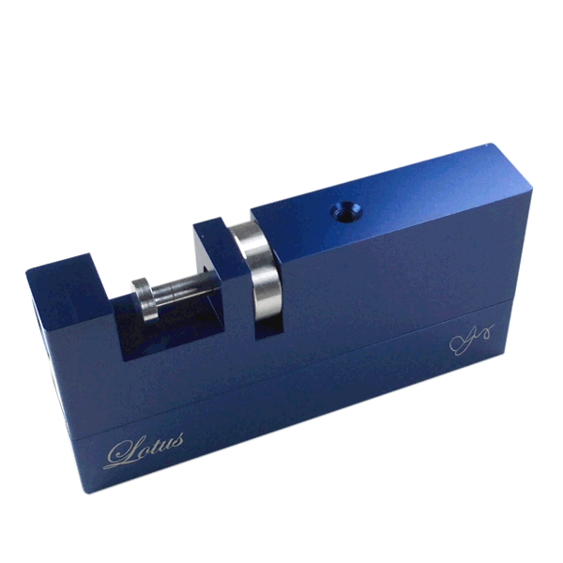
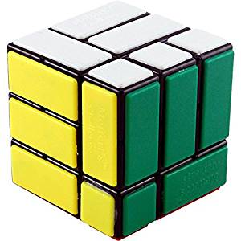
Seperti puzzle

Slide 9
Artinya?
Berpikir kreatif.
Terus menerus belajar hal yang baru.
Tertantang untuk memecahkan masalah.
Sangat mungkin memakan waktu yang tak sedikit.

Slide 10

Jangan patah semangat

Slide 11

Motivasi
Interfacing
Improve documentation shortcomings
Bug Fixing
Creation of unlicensed duplicates
Repurposing
Finding security bugs
For fun (and profit)!

Slide 12


Perseteruan abadi
Reverser dan Developer sering bersaing satu sama lain.
Developer ingin melindungi kekayaan intelektualnya.
Reverser ingin memecahkannya.
Siapa yang tertawa di akhir?

Slide 13
Reversing itu Luas!
Software
1
Hardware
2
Protocol
3
Data Format
4

Slide 14


Slide 15


simak Kisah suksesnya

Slide 16
Alchemy Reversing
01
02
03
Comprehension
Decomposition
Reconstruction
Gain knowledge of basic principle or mechanics of objects.
Breaking down the system into its structure and gain insight of components that make the system
Reform or reconstruct the components based on need.

Slide 17

Slide Title
Ragam Praktik Reversing

Slide 18

Binary analysis
Analisis Kode Secara Statis dan Dinamis
Disassembly
Decompile
Debugging
Instrumentation
Code Emulation
Symbolic Execution
Notes:
Disassembly:
Radare2 (https://www.radare.org/r/)
IDA Pro
Capstone Engine (www.capstone-engine.org/)
Decompiler
IDA Pro
RetDec (https://retdec.com/)
Snowman (https://derevenets.com/)
Debugging
GDB
Radare2
WinDbg
Immunity Debugger (https://www.immunityinc.com/products/debugger/)
X64dbg (https://x64dbg.com)
Instrumentation
Frida (https://frida.re)
Intel PIN (https://software.intel.com/en-us/articles/pin-a-dynamic-binary-instrumentation-tool)
DynamoRIO (http://www.dynamorio.org)
Code Emulation
Unicorn Engine (https://www.unicorn-engine.org/)
Symbolic Execution
Z3
KLEE
Assembler (programmatically):
Keystone Engine
AsmJIT (https://github.com/asmjit/asmjit)

Slide 19
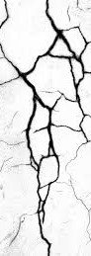
Binary modification
Perubahan di Luar Kendali Pengembang
Byte Patching
Control-Flow Bypass
Resource Modification
Keygen

Slide 20

Format analysis
Mencari Keteraturan dalam Data Acak
File Format Identification
Pattern Analysis
Hex Editing
Visualization
Notes:
File Format Parser:
Kaitai Struct (https://kaitai.io/)
Binary Data Visualization
Veles (https://codisec.com/veles/)

Slide 21
Reversing
Dalam Cyber Security

Slide 22



Slide Title
Malware Reverse Engineering
Mencari artifact
Lokasi C&C Server
Keluarga malware
Eksploit yang digunaka
Analisis kelakuan

Slide 23

Slide Title
Exploit Development
Mencari bug
utamanya pada closed source application.

Slide 24

Slide Title
Mobile Apps Reversing
Mencari artifact
Cari API endpoint
Cari secret key
Cari checksum
Mencari bug

Slide 25

Karir Reverser?
“Tidak ada pekerjaan yang lebih menyenangkan daripada hobi yang menghasilkan uang”

Slide 26
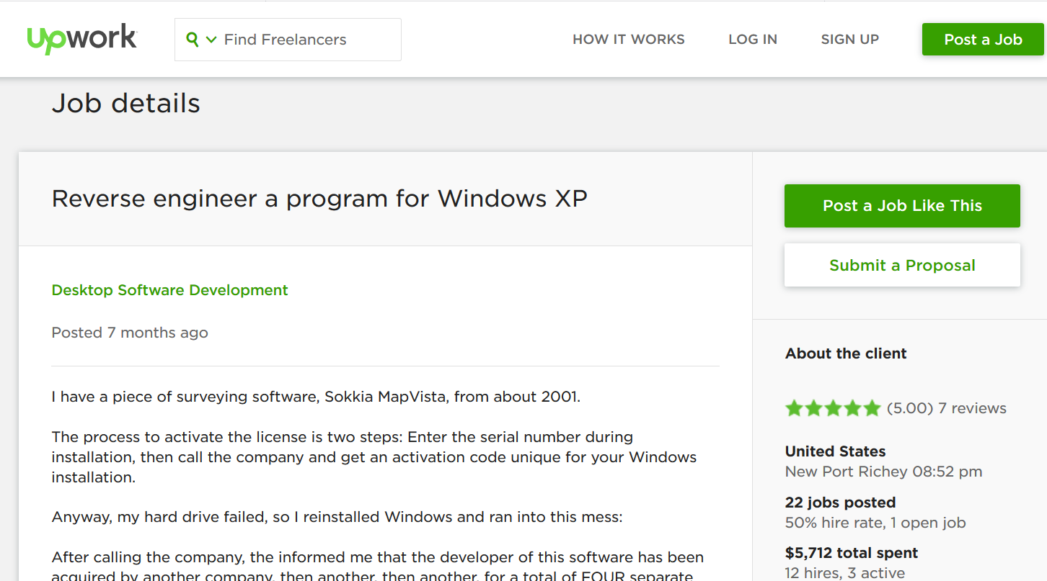
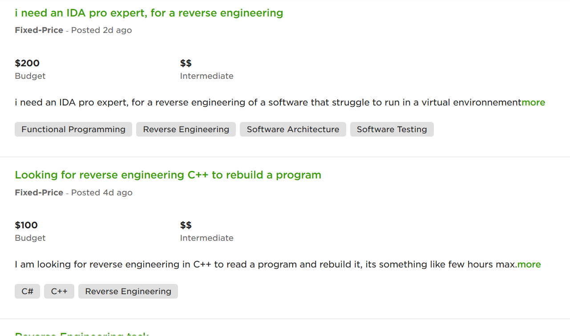
Freelancing?

Slide 27
Pekerjaan tetap?
Kebanyakan perusahaan Endpoint Security butuh Malware Reverser
Lihat juga: https://www2.fireeye.com/WBNR-14Q3FLAREWebinar.html

Slide 28
Sertifikasi?
GREM
CREA
eCRE
CCMRE
Notes:
eCRE = eLearnSecurity Certified Reverse Engineer (https://www.elearnsecurity.com/certification/ecre/)
GREM = GIAC Reverse Engineering Malware (https://www.giac.org/certification/reverse-engineering-malware-grem)
CCMRE = CREST Certified Malware Reverse Engineer (https://www.crest-approved.org/examination/malware-reverse-engineer/index.html)
CREA = Certified Reverse Engineering Analyst (http://www.iacertification.org/crea_certified_reverse_engineering_analyst.html)

Slide 29
Masa Depan
Reversing
Notes:
Research on Automatic Binary Exploitation, Software Verification, Formal Method enhanced with Artificial Intelligence.

Slide 30







THANK YOU
Reversing.ID
Satria Ady Pradana (xathrya)
+62 89 774 23935
xathrya@reversing.id
http://reversing.id

Slide 31
SAMPAI JUMPA!
https://t.me/ReversingID
https://fb.me/Reversing.ID
https://github.com/ReversingID
https://reversing.id

